Slide 1

Design Document Prototype 2
Name: Edgar Pereira
Username: P010519P
Procedural dune traversal prototype inspired by games such as Dune!, Journey and endless runner which are focused on momentum, physics and atmosphere.

Slide 2
Game Mechanics
The game focuses on momentum-based movement where the player controls a ball travelling through procedurally generated sand dunes. Unlike my first prototype which focused on platforming, this prototype focuses more on physics, speed, satisfaction and flow. The player gains momentum by sliding down slopes and loses momentum when climbing upwards meaning movement constantly changes depending on terrain shape.
The core mechanic is based around keeping speed and using the dunes properly. Holding input to increase gravity at the wrong time can remove momentum whilst landing correctly on slopes can massively increase speed/velocity. The player can also launch into the air for score multipliers if enough speed is built up.
The terrain itself is procedurally generated using spline-based dune generation. This means the environment continues infinitely whilst changing shape over time, gradually getting harder. Earlier during development, I tried using a treadmill idea where around 10-20 terrain chunks would constantly recycle around the player instead of being destroyed. The goal of this was to save performance and reduce lag caused by constantly generating and deleting objects. I also experimented with moving the floor instead of the player to fake movement, but this became complicated with physics, so I instead focused on procedural generation.
The game also includes a score system based on height reached. Players gain higher score multipliers when flying higher above the dunes which encourages risky play and maintaining momentum.
Example code:
if (player.position.y > startMultiplierY)
{
float extraHeight = player.position.y - startMultiplierY;
currentMultiplier = 1 + Mathf.FloorToInt(extraHeight / heightStep);
}
The movement and physics required a large amount of tweaking because initially the ball either lost too much speed or gained unrealistic momentum. I repeatedly compared the feel of my prototype to the original mobile game inspiration and constantly adjusted gravity, drag and force values until movement felt satisfying/rewarding.

Slide 3
Objectives
The main objective is to survive the desert and continue travelling forward whilst maintaining momentum. Unlike other games with multiple levels, progression is based on score and distance travelled.
The player starts after crashing deep within an abandoned desert wasteland. Through radio transmissions and dialogue the player slowly uncovers hints about what happened and attempts to escape. The game ends once the player reaches a target score of 50k and activates the ending sequence, although players can choose to continue endlessly afterwards.
The game is designed around atmosphere and flow. Players are also encouraged to keep travelling further and improving their movement whilst uncovering more story and environmental storytelling.

Slide 4
Core Gameplay Loop
The gameplay loop is based on movement, momentum and survival.
This gameplay loop constantly rewards players for improving movement whilst also creating relaxing but tense gameplay due to the increasing speed and effects.
Spawn into desert
Build momentum through dunes
Launch into air
Gain score
Avoid losing momentum
Continue endlessly
Choice
Unlock more story
Reach higher distances
Reach ending

Slide 5
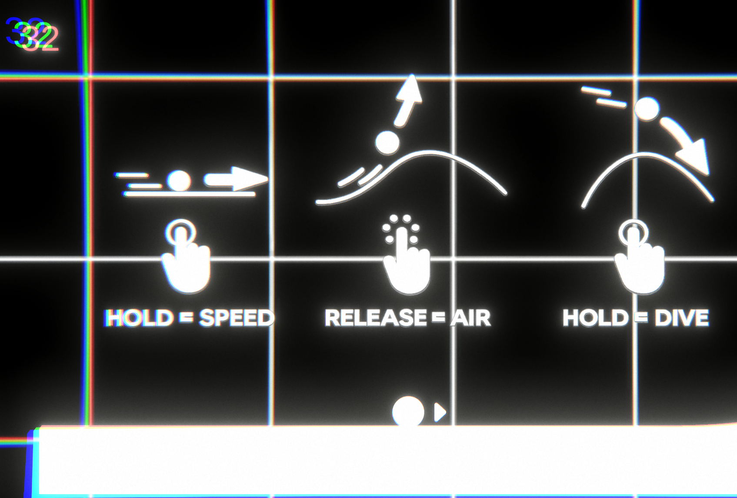
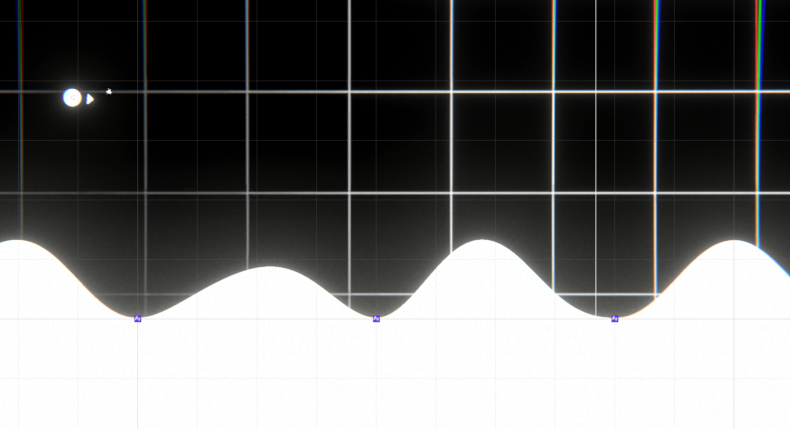
Level Design
The world uses endless procedural generation rather than a built level. Dunes are generated using Sprite Shape splines and randomized terrain points. The generation tries to create smooth slopes that naturally flow together so movement feels satisfying.
At the start the dunes were either too steep or too sharp which caused physics issues and Sprite Shape tessellation errors. This happened because spline points were overlapping or placed too closely together. To solve this, I reduced point density and increased spacing between generated spline points.
Visual design focuses heavily on minimalism. The environment uses large empty dunes, moving background, post processing and lighting to create a feeling of isolation. Music and radio effects also change over time, becoming more distorted as the player gets further.
Tutorial prompts are shown at the beginning explaining movement controls and mechanics with a top score next to it at the end.
Basic tutorial
Basic Dunes that have
Been generated by my spline
script
Player

Slide 6
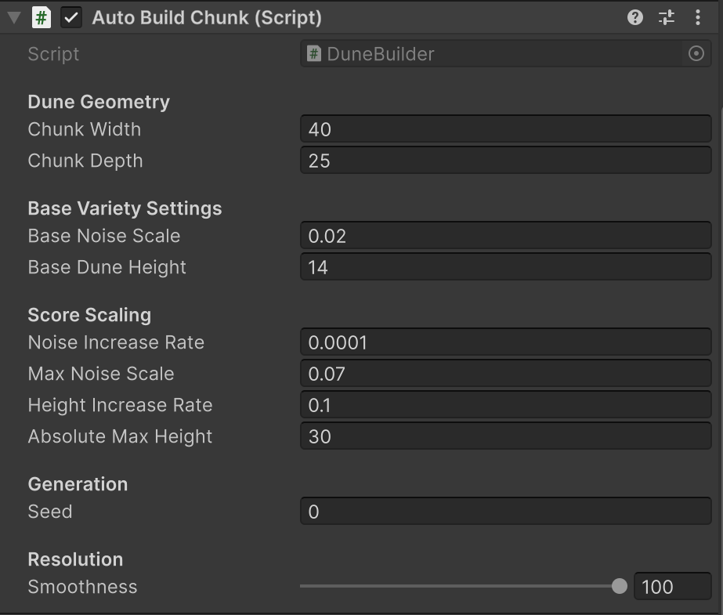
Systems Development
This prototype contains significantly more systems than my previous game.
Some of the main systems include:
- Procedural dune generation
- Momentum based physics system
- Score and multiplier system
- Dialogue system
- Dynamic music system
- Radio distortion system
- Pause menu
- Story ending system
- Post processing system
One important system is the procedural terrain generation. This generates dunes infinitely whilst trying to maintain smooth terrain. Another important system is the dynamic audio manager which changes music depending on player score and smoothly transitions between tracks.
Example code:
audioSource.volume = Mathf.Lerp( audioSource.volume, targetVolume, Time.deltaTime * fadeSpeed );
I also created a dialogue system where radio messages appear at specific scores. At the start messages are clear but later become heavily glitched and distorted to match the story progression.
Example code:
if (currentScore >= dialogueList[dialogueIndex].scoreTrigger) { StartCoroutine( PlayDialogue(dialogueList[dialogueIndex].message) ); }
The dialogue system also includes typing effects, fade animations and radio sounds which become more corrupted over time. These small details added a lot to the story.

Slide 7
Story and Atmosphere
One weakness identified during feedback was that the game originally lacked story elements. To improve this, I added a narrative systems through dialogue, radio communication and an ending.
The player is implied to have crashed deep within the desert whilst attempting to reach a structure known as the Forge. Throughout gameplay a radio attempts to guide the player forward whilst transmissions become increasingly unstable.
At lower scores the radio sounds clear and understandable. At higher scores both the audio and text begin glitching heavily which visually reinforces the idea that systems are failing.
Example dialogue progression:
"Signal restored. Keep moving east."
"Energy levels stable. You are close now."
"tr@nsmi$$ion corr%pted..."
"y0u sh0uld n0t h@ve c0me h3re..."
This helped make the game feel more connected and atmospheric rather than just a sandbox game.

Slide 8
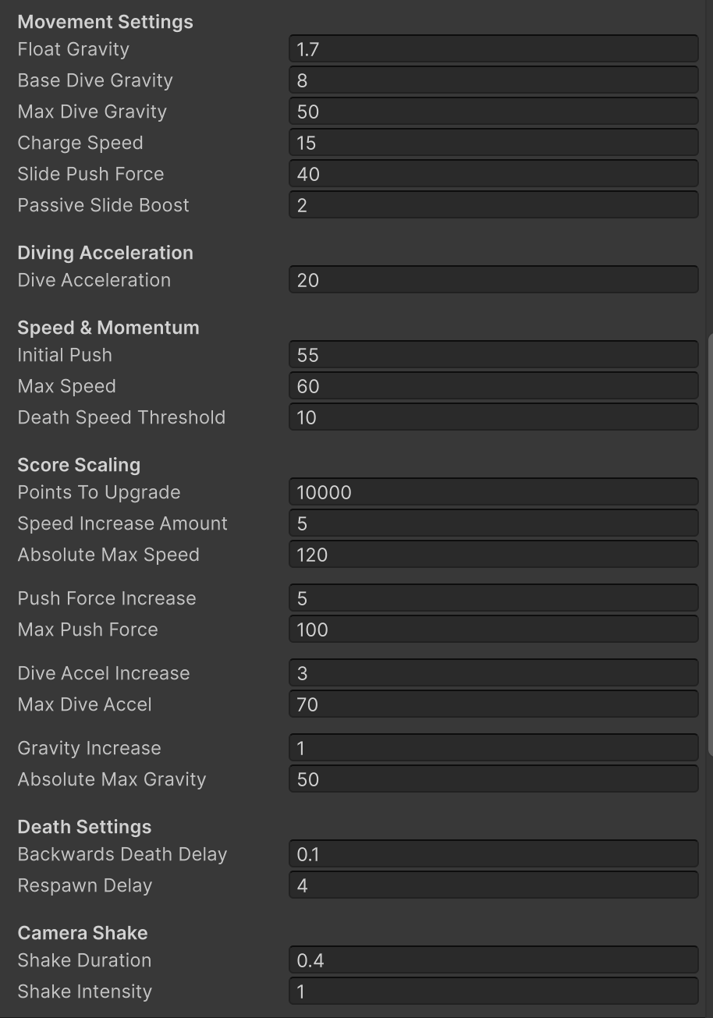

Problems and Solutions
Several issues happened during development. One massive issue was balancing the physics system. Early versions either felt too floaty or completely killed momentum after landing. This made moving unsatisfying. I solved this through testing and tweaking gravity, drag and launch but this took a lot of my time.
Another issue involved Unity Sprite Shape tessellation errors caused by spline points overlapping. Although the terrain still rendered correctly, Unity constantly displayed warnings. This was improved by reducing the amount of spline points and increasing spacing between them. I'm not sure if its worth fixing properly as the dunes render fine with the warning.
UI systems also caused problems. At one point the pause menu resume button could not be pressed because another invisible UI object was blocking raycasts. This was fixed by checking the canvas hierarchy and raycast target settings.
I also struggled with scope management. Compared to the first prototype this project became significantly more ambitious due to procedural generation, advanced physics, dynamic audio and story systems. Because of this I experienced burnout during weeks 2 and 3 after doing most major systems during week 1. This taught me the importance of controlling scope and planning development more realistically.

Slide 9
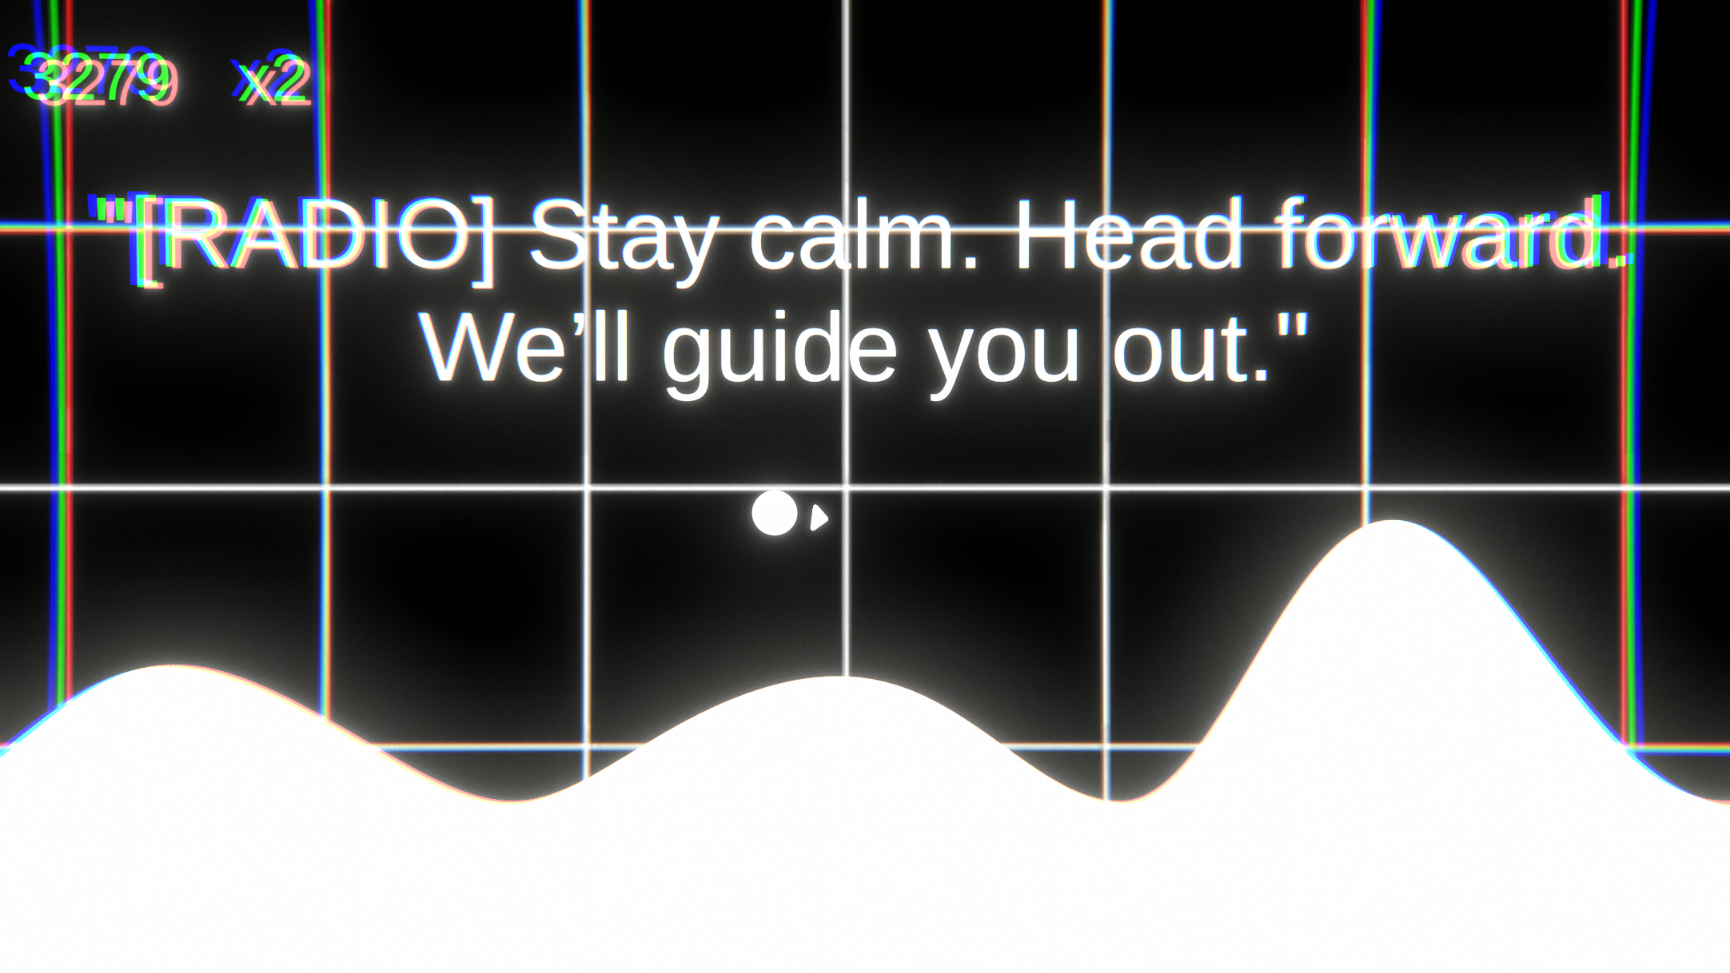
Testing and feedback
Testing was extremely important because momentum-based movement depends heavily on feel rather than visual. Feedback showed that players enjoyed the speed and atmosphere but most initially struggled understanding how the momentum worked. To test this wasn’t an issue with my game and more with the idea I also had people try the original Dune! Game and results were very similar.
To improve this, I adjusted the starting terrain and added tutorial prompts explaining how slopes affect speed.
Players also liked the creepy atmosphere, especially the distorted radio messages and evolving soundtrack (stole it from Elden Ring). The combination of music, procedural terrain and post processing helped create a sense of isolation.
Some people mentioned that the procedural generation occasionally produced awkward terrain shapes, however overall feedback on the dune traversal was positive.

